Slide 1
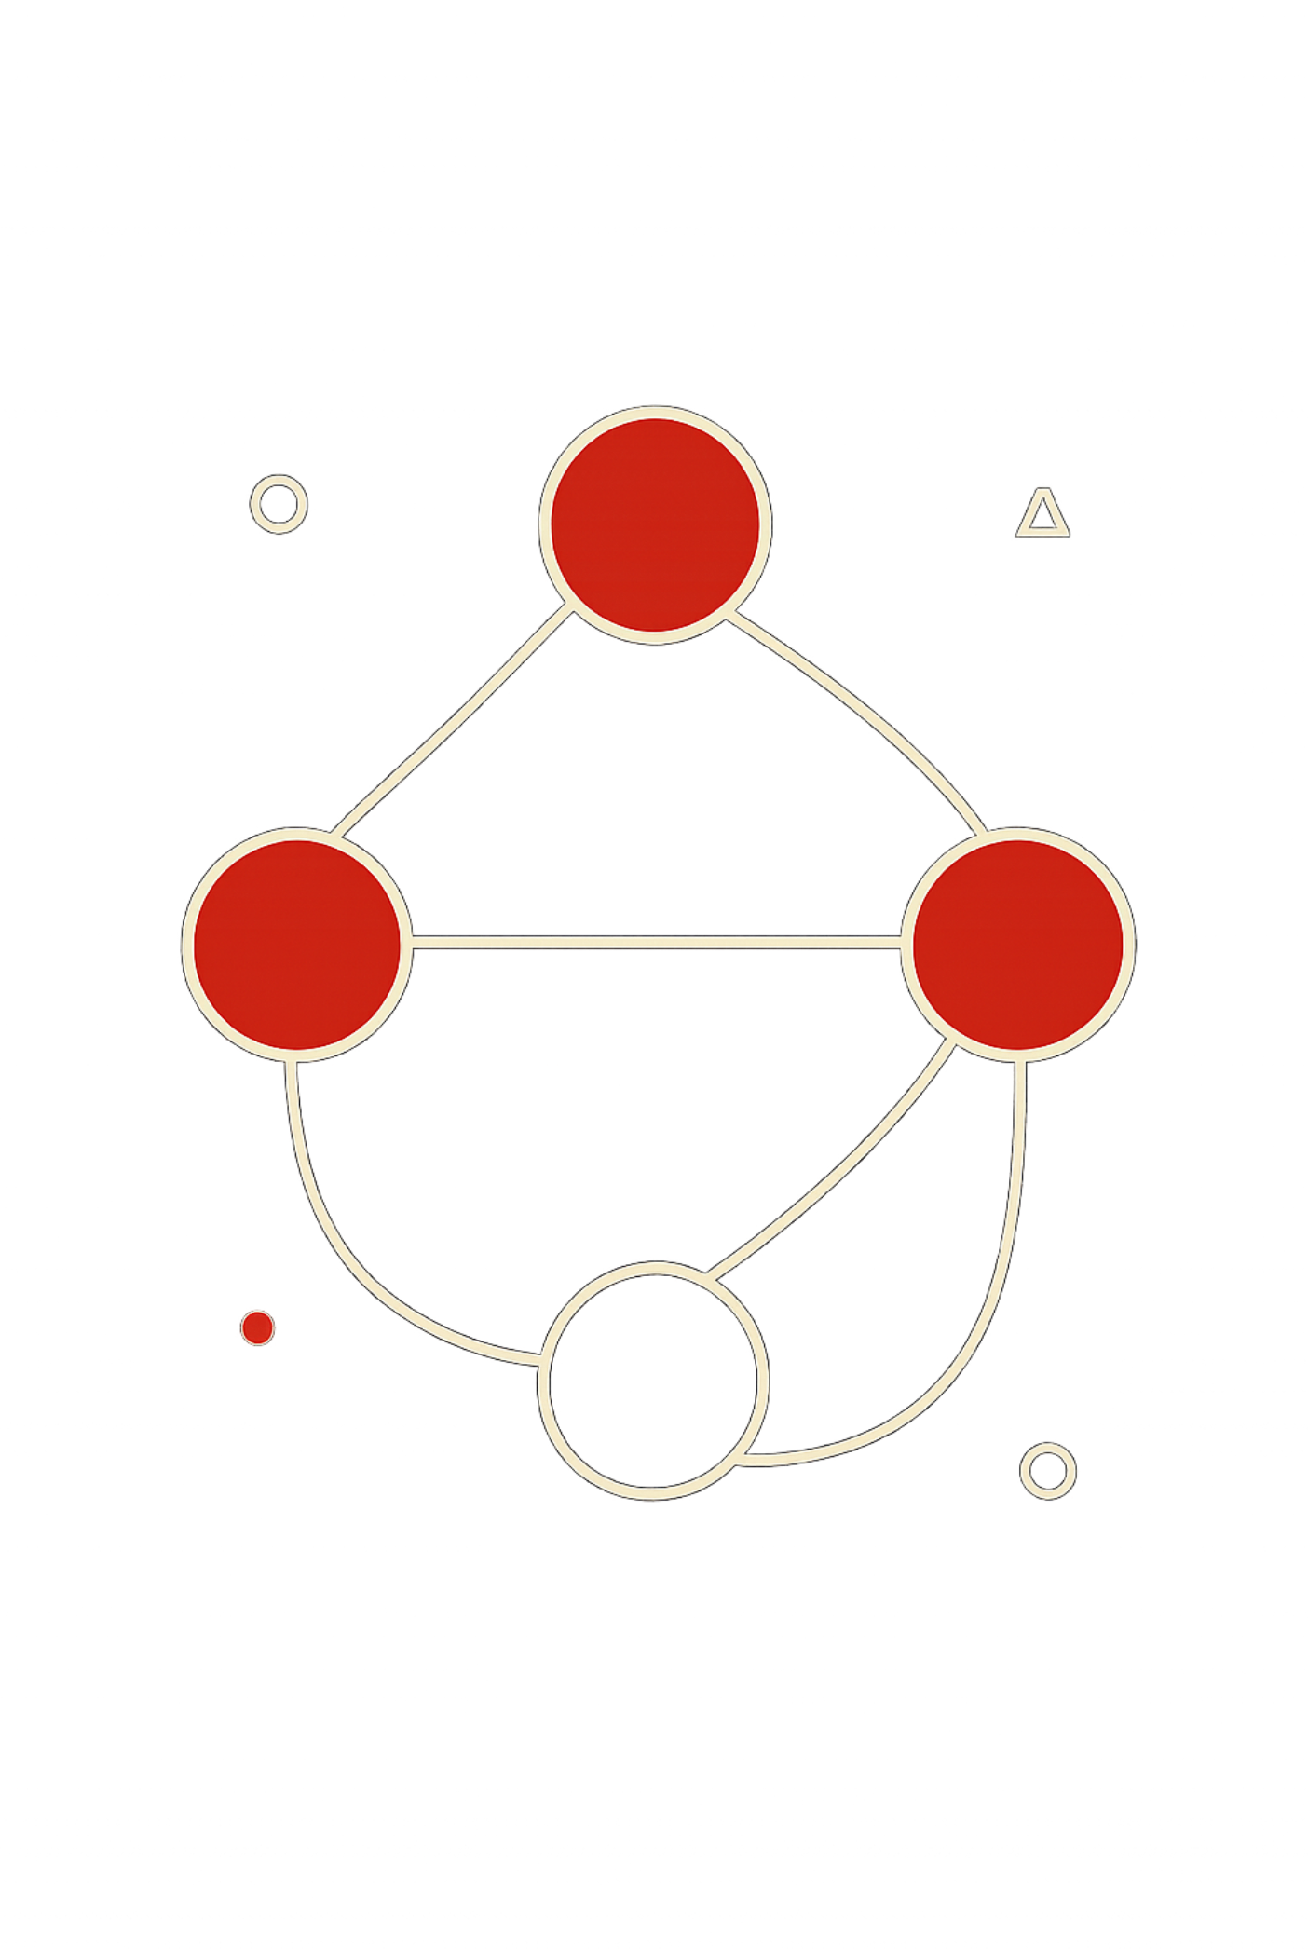
Project Scheduling with Precedence Constraints
A Graph-Based Dual-Engine Optimization System for Data Structures and Algorithms
Directed Acyclic Graphs • Overwatch (Managerial CPM) • Overdrive (Gamified Quests)

Slide 2
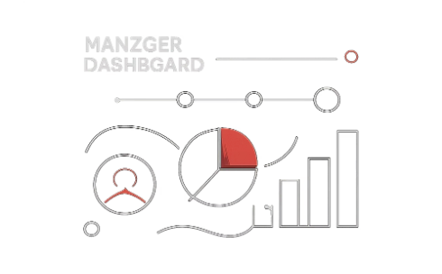

The Dual-Engine Concept
Overwatch Mode
Overdrive Mode
Sturdy managerial view focused on reliability: Critical Path Method, deadlock detection, and precise float/slack computation for schedule assurance.
High-octane gamified layer that converts bottlenecks into tiered quests, streaks, and EXP rewards to boost developer engagement and prioritization.

Slide 3
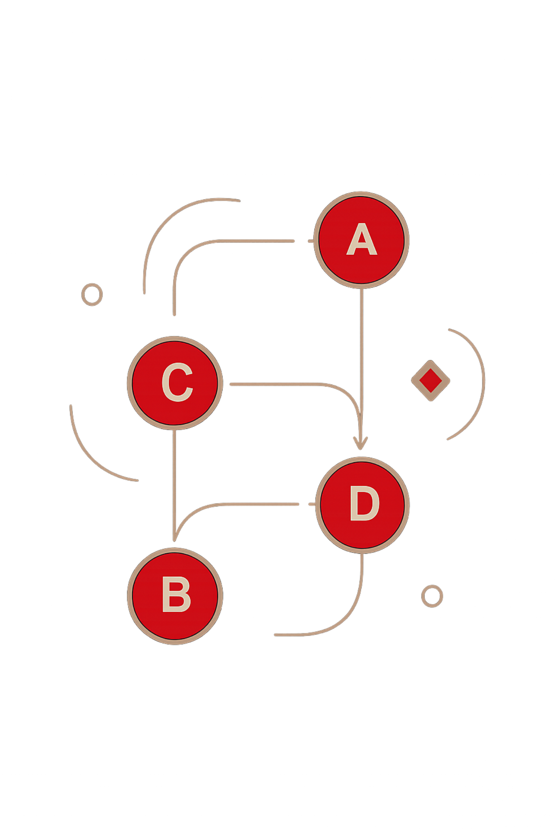
Theoretical Graph Modeling
Model: DAG G = (V, E). Each vertex v ∈ V represents a task with a duration; each directed edge (u → v) is a precedence constraint requiring u before v.
Storage: Adjacency list for O(V + E) space.
Operations: Edge traversal and neighborhood queries in O(V + E) time.
Assumptions: No cycles; tasks have non-negative durations.

Slide 4
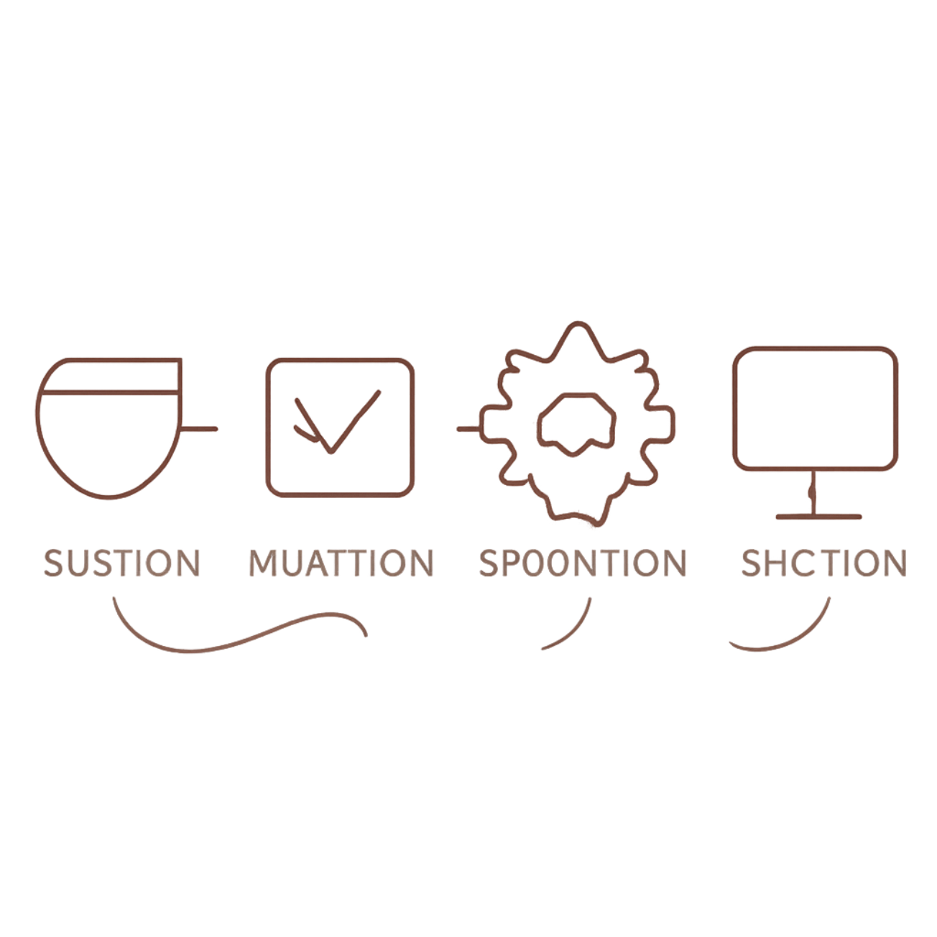
Pipeline Architecture
01
1. Task ingestion
Parse task metadata, durations, and dependency edges.
02
2. Kahn's cycle detection & topological sort
Detect cycles; produce an execution order if acyclic.
03
3. CPM calculation
Compute EST/EFT and LST/LFT; identify critical path(s).
04
4. Dual rendering
Render Overwatch dashboard and Overdrive quest map simultaneously.

Slide 5

Overwatch Mode — Manager Dashboard
Operational view designed for correctness and predictability.
Deadlock-free ordering
Critical Path Identification
EST / EFT / LST / LFT
Earliest and latest time boundaries computed per task enable precise float calculations.
Topological ordering ensures feasible execution sequences when DAG validated.
Tasks with zero slack are flagged as bottlenecks for prioritization and contingency planning.

Slide 6
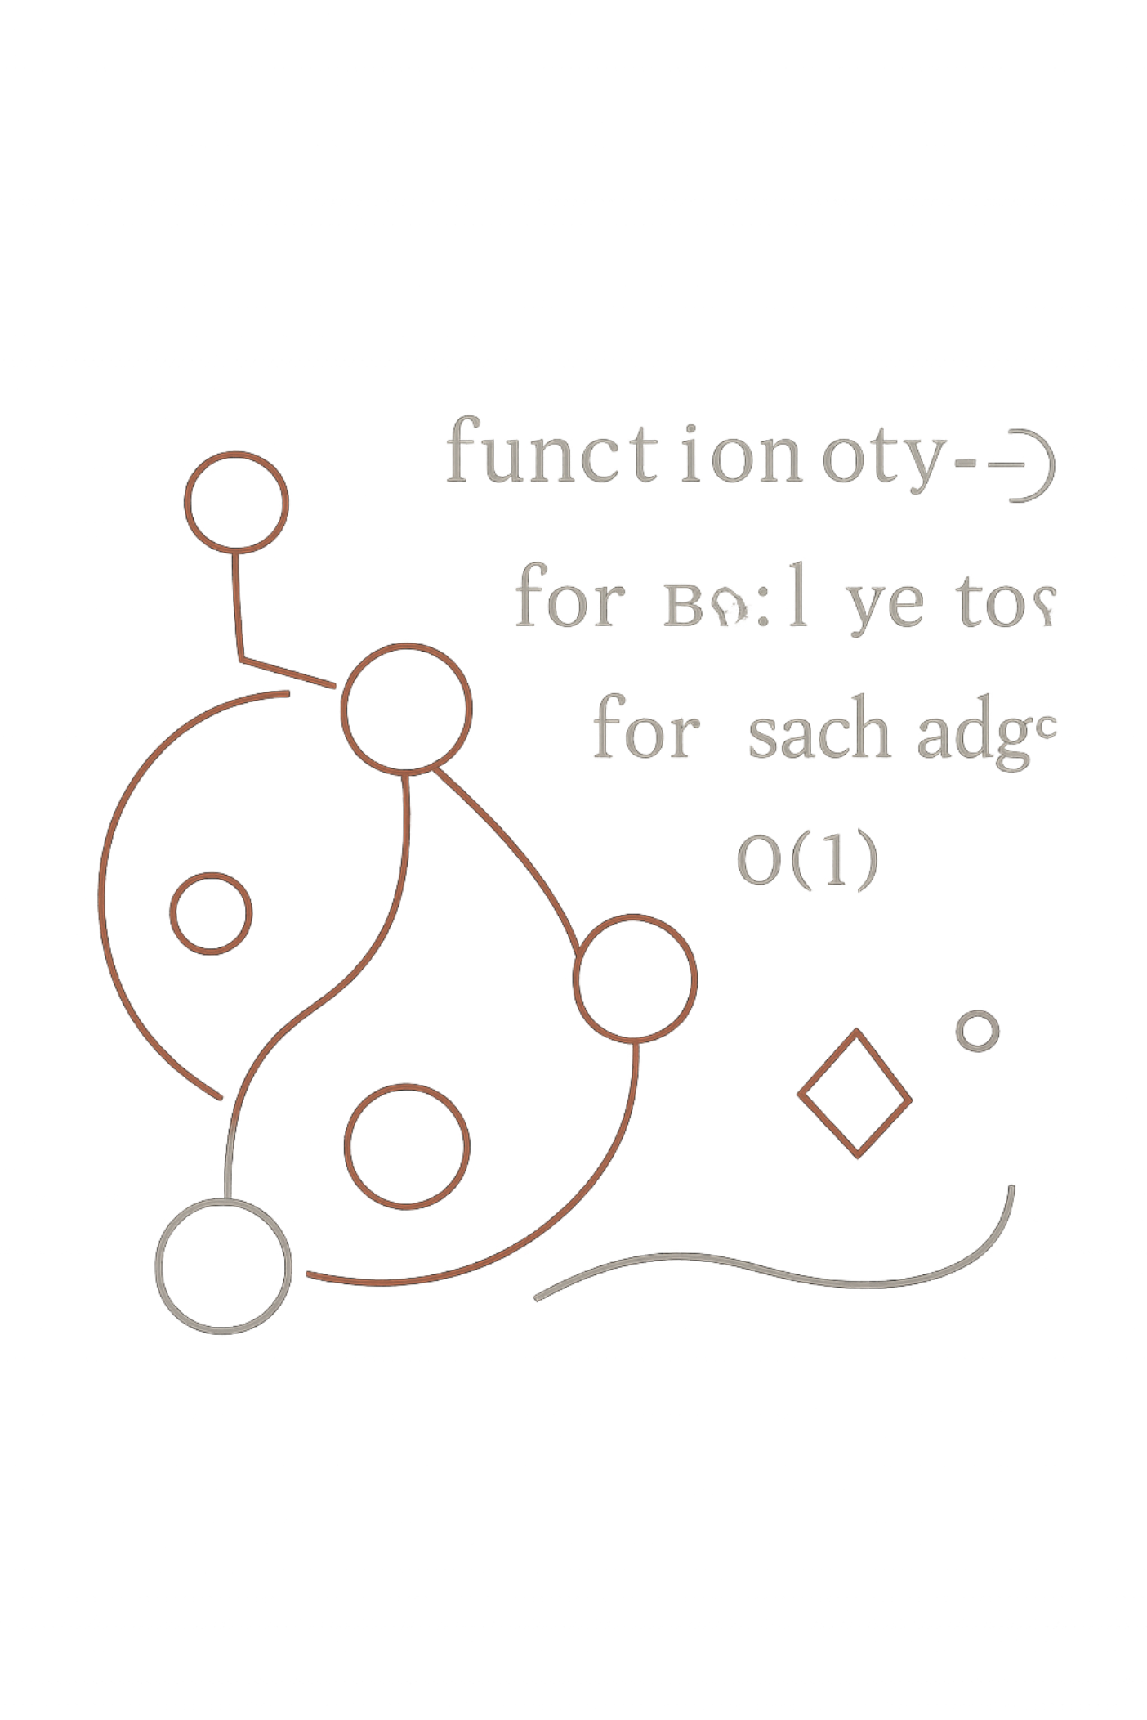

Algorithmic Complexity & Benchmarks
The core algorithms operate in linear time relative to graph size:
Topological sort & Kahn's cycle detection: O(V + E) time, O(V + E) space.
CPM (forward/backward passes): O(V + E) — single pass per direction.
Memory: adjacency lists keep footprint minimal for large task graphs (thousands+ nodes).
Designed for real-time resolution: typical production graphs (10k–100k edges) complete within interactive latency targets.

Slide 7
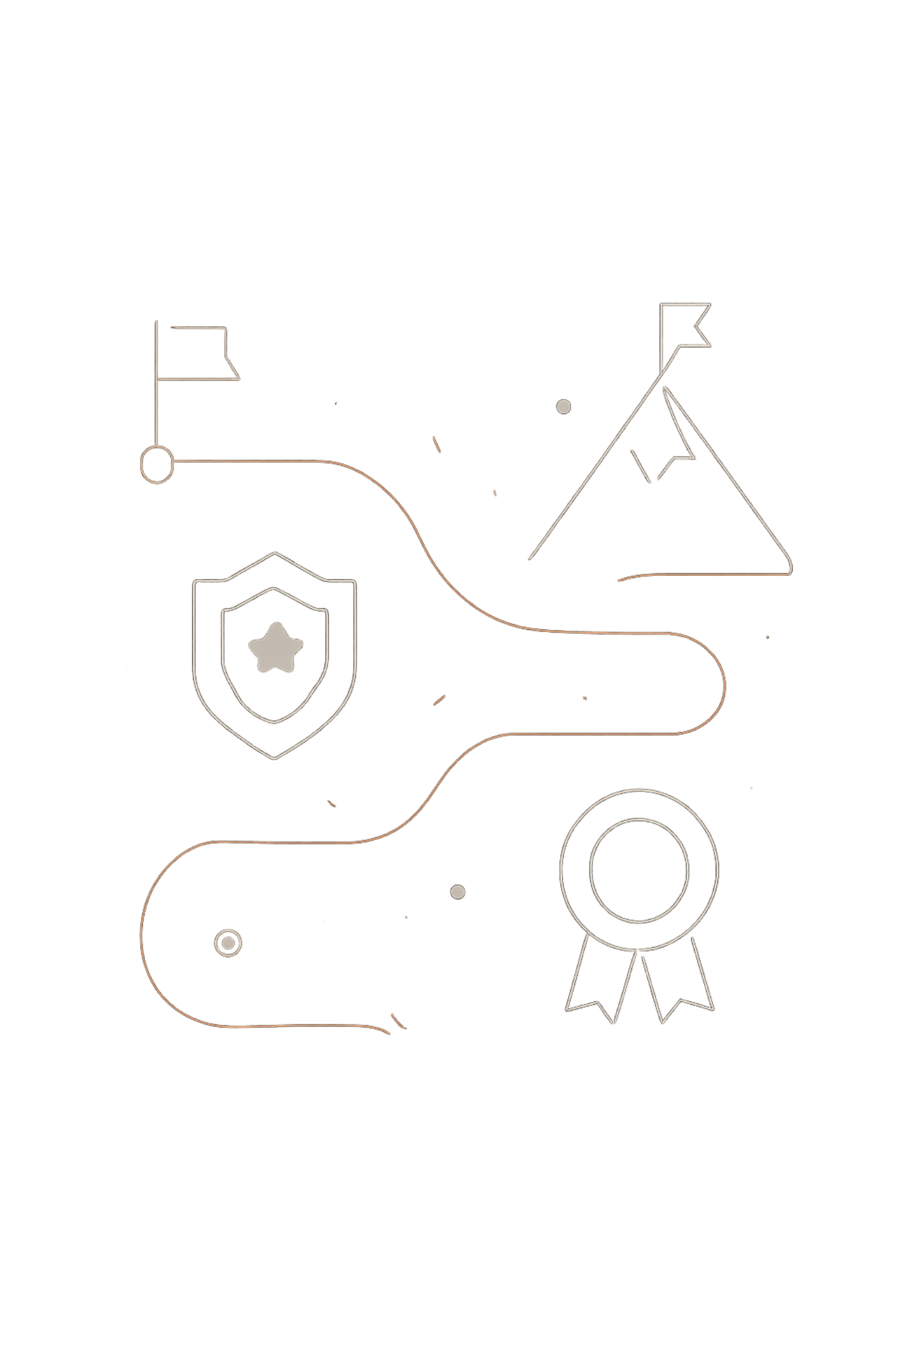



Overdrive Mode — Gamified Quest Engine
Translate scheduling signals into behavioral incentives to guide team focus without sacrificing correctness.
Boss Quests
Critical-path tasks become boss-level challenges with team-wide priorities.
Rarity & Rewards
Task rarity (Common→Legendary) maps to XP multipliers and visibility boosts.
Streaks & Priority Queues
Priority-queue–based scheduling rewards consecutive on-time completions with increasing EXP.

Slide 8
Task Rarity Matrix
Rarity | Definition / Examples
Common | Basic setup tasks: small, independent, low-degree vertices.
Uncommon | Standard tasks with a few dependencies; short-duration contributors.
Rare | Hub nodes with high in/out degree — potential local bottlenecks.
Epic | Sub-critical milestones whose delay affects downstream parallelism.
Legendary | Apex critical-path boss tasks: zero slack, highest priority in Overwatch and Overdrive.

Slide 9

Validation
Ingestion
Optimization
Dual Rendering
Lifecycle overview: ingest tasks → validate acyclicity and constraints → optimize schedule via CPM and priority heuristics → render both managerial and gamified views for execution.

Slide 10



Expected Outcomes & Next Steps
Correct, conflict-free schedules
Precise bottleneck detection
Topological guarantees plus CPM ensure valid execution orders and transparent slack metrics.
Zero-slack tasks surfaced for mitigation and targeted resource allocation.
Engagement through gamification
Deliverables
Prototype implementation, benchmark suite (O(V+E) verification), demo dashboards for Overwatch & Overdrive, and integration guide.
Overdrive mechanics encourage timely completions and strategic parallelism without compromising correctness.
Questions?
Combine algorithmic rigor with behavioral design — ready for technical review and live demo.

